Slide 1
“Online Food Delivery Service”

Slide 2
Introduction
Presented by:
Prithviraj Chowdhury ID: 2254901101
Abrar Zawad
ID: 2254901049
Jablay Noor Rahman
ID: 2254901093
Section-A
BICE-2022
Presented to:
Afrina Khatun
Lecturer
Department of Information and Communication Technology
Faculty of Science & Technology (FST)

Slide 3
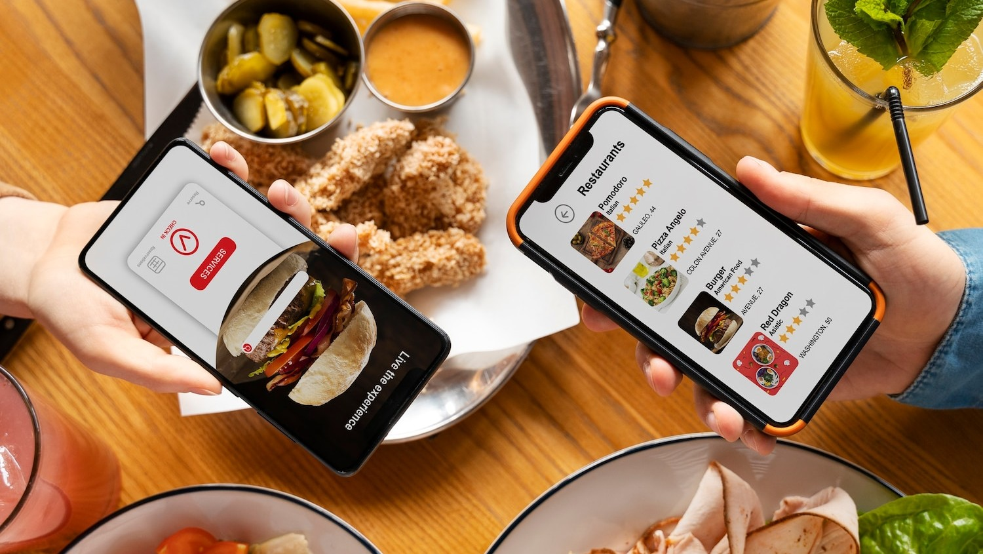
The Food Industry Landscape
The food industry is constantly evolving, with consumers demanding convenience and efﬁciency.
Our Project aims to meet these demands by providing a seamless online food delivery experience. With its cutting-edge technology and Java- powered backend. The project is set to revolutionize the industry.

Slide 4

Project Overview KHUDA LAGSE
KHUDA LAGSE is an innovative online food delivery service that leverages the power of Java to provide a user-friendly and efﬁcient platform. With a wide range of food items, an easy ordering process, and extravagant features, KHUDA LAGSE aims to become the go-to choice for food enthusiasts.

Slide 5
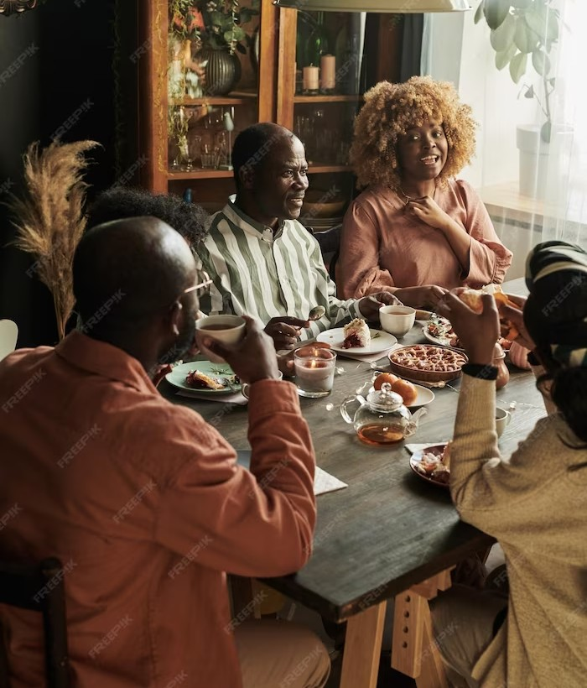
Key Features
Add New Product
Within the "Add New Product" section, the administrator has the capability to include fresh products, specifying both the product name and its corresponding price within a designated category.
Change Password
Both the user and the administrator have the option to reset their passwords by answering their respective security questions.
Manage Category
In the "Manage Category" section, the administrator can introduce new food categories into the category table, and subsequently, these categories are stored in the database for future use.
stage.
Total Revenue
Under Total Revenue, the admin can see all the money generated from the orders placed by the users including the total list of orders.

Slide 6

Key Features
Place Order
In the "Place Order" section, users can select food items to place an order. Each time they click on a food item, an image of the selected food will appear. Users have the flexibility to adjust the quantity of the selected items. However, the final bill will not be generated unless they provide their name and phone number. Once these details are provided, a PDF of the bill will be generated at a later stage.
Verify Users
In the Verify Users section, admins can verify new user accounts to allow access to the application's features, and disable existing user accounts.
View Bills Order History
In the View Bills Order History section, admins can view a table of all orders placed by users, including the user's name, email address, total amount, phone number, and date. Admins can also filter the table by date or search by user name. Additionally, admins can sort the table in ascending or descending order by any column.

Slide 7
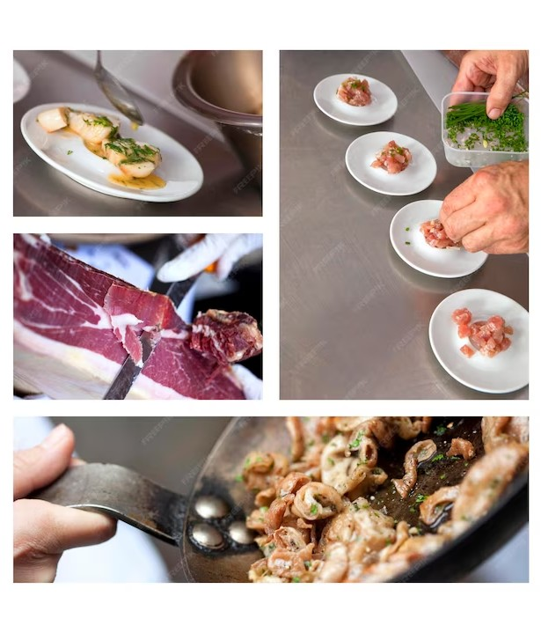
Key Features
View, Edit and Delete Product
Under View, Edit, and Delete Products, admins can view a list of all products in their respective categories, including the product name, price, and product ID. Admins can also edit the product name, price, and category.
View Order History
Under View Order History, users can view a list of all orders they have placed in the app, including the order name, total amount, order ID, phone number, email, order date, total payment, and created by. Users can also click on an order to view a PDF of the bill.
Slide Show of the Food Items
The food items will be displayed in a slideshow that slowly shuffles. Users can close the slideshow at any time, or click on the button to display it again.

Slide 8
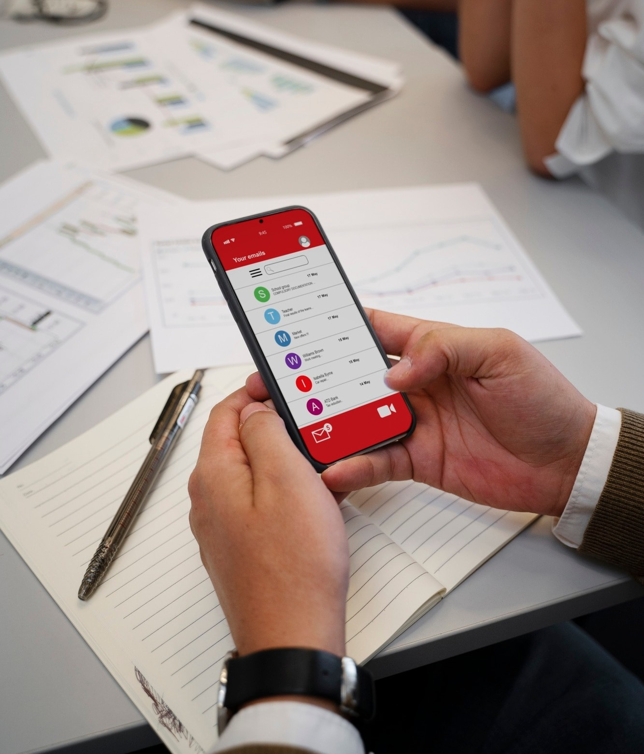

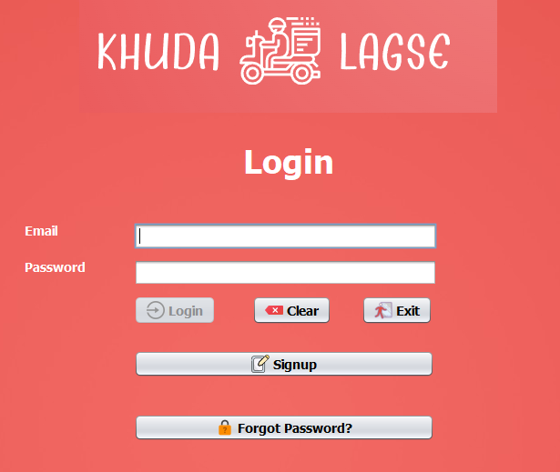
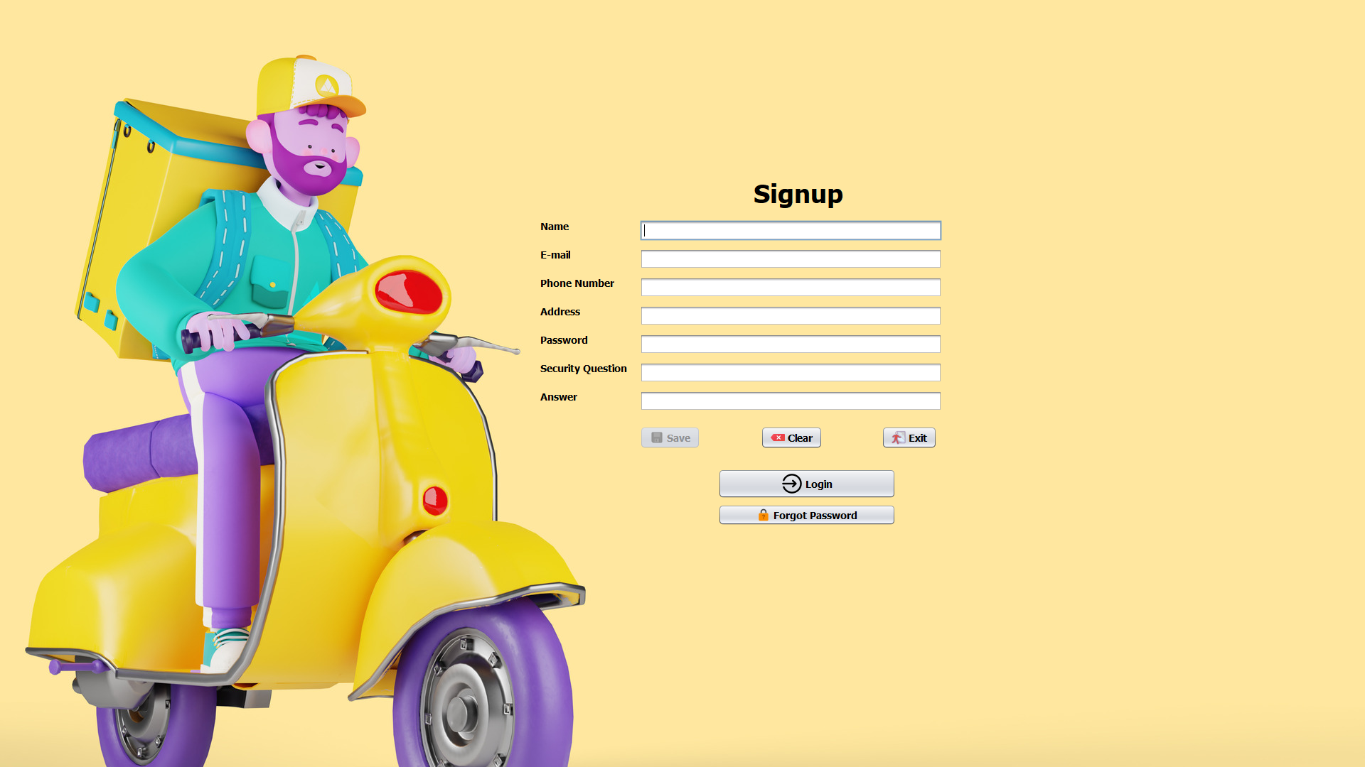
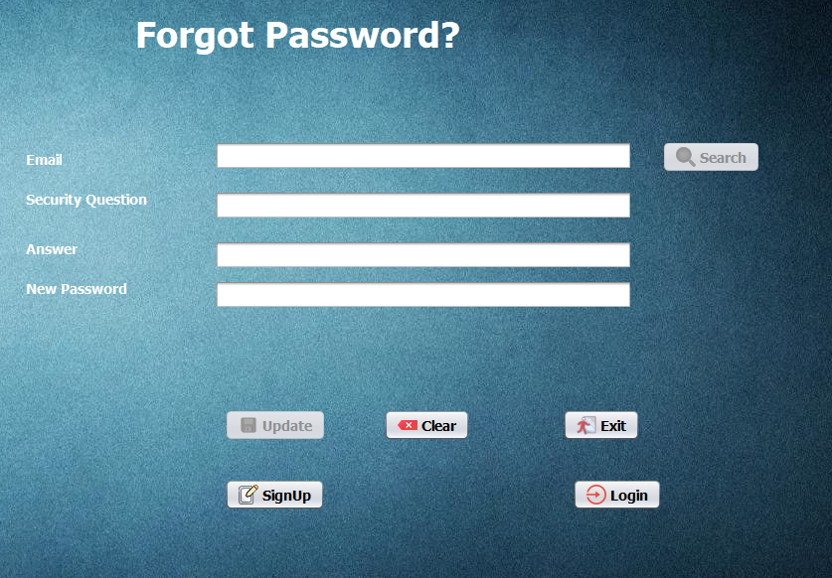
Not actually a feature but a necessity!
Login
Signup
Forgot Password

Slide 9
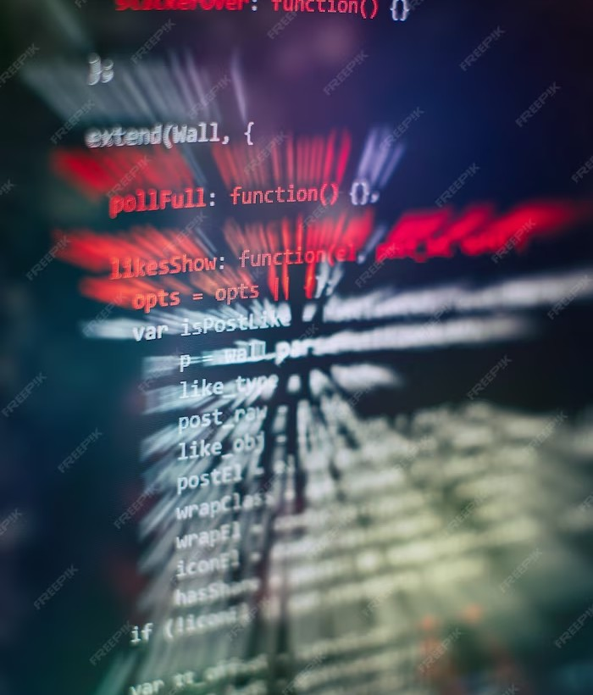
THE JAVA ADVANTAGE
Java, a robust and versatile programming language, forms the backbone of this project. Its scalability, security, and cross-platform compatibility make it an ideal choice for developing a reliable online food delivery service. Java ensures a seamless user experience and enables our project to handle high volumes of orders.

Slide 10


Thanks!

